Slide 1




JWT
JSON WEB TOKEN
Presented By Suparna Dhar

Slide 2
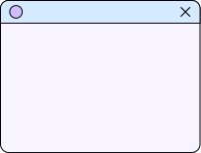
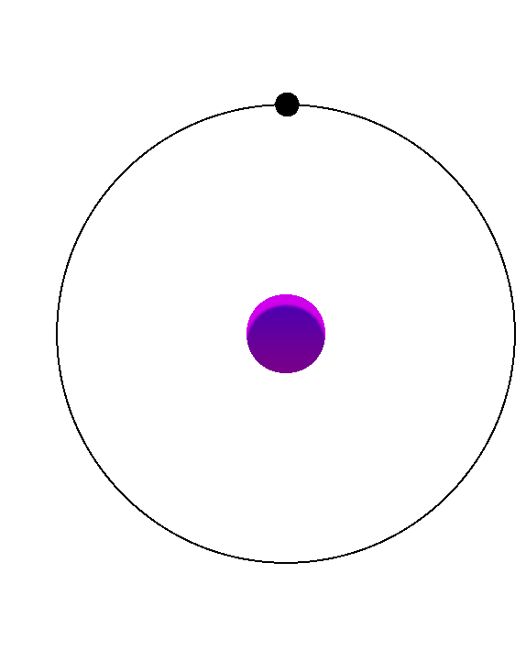
INTRODUCTION
JWT stands for JSON Web Token. It’s a small and secure way to send information between two systems
JWT
JSON
WEB
Token

Slide 3

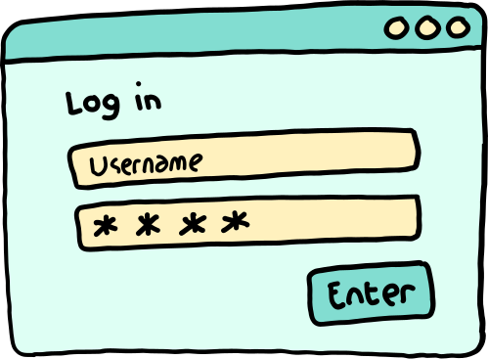

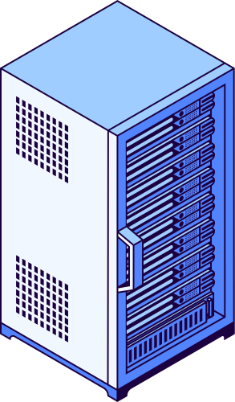
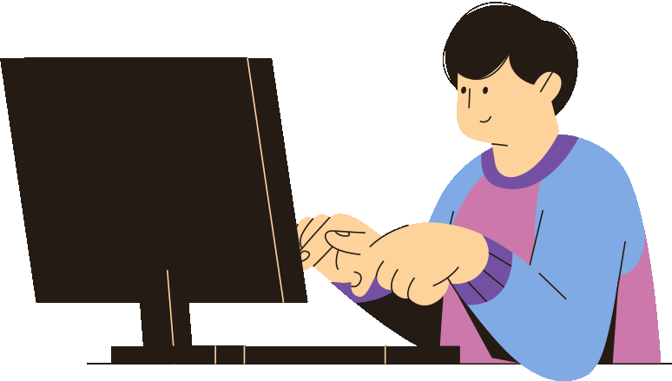
Dynamic Website
Request
Response HTML
SERVER
CLIENT

Slide 4

Dynamic Website
Request Diff Route
I did not know this user
SERVER
CLIENT

Slide 5
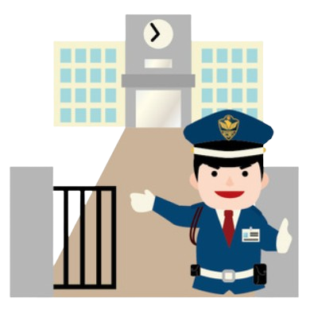
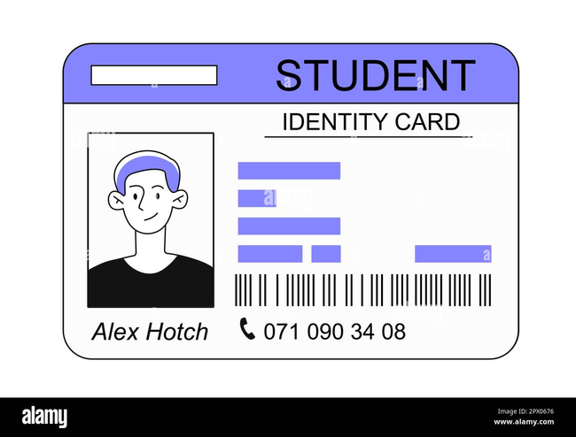


LET’S THING A SCENARIO
Rahul A University Student

Slide 6

LET’S THING A SCENARIO
Rahul A University Student

Slide 7

LET’S THING A SCENARIO
Caffeteria
Rahul A University Student

Slide 8
HERE COMES THE JWT MAGIC
Caffeteria
Rahul A University Student

Slide 9
HERE COMES THE JWT MAGIC
Caffeteria
Rahul A University Student

Slide 10



JWT STRUCTER
Enconded
Header
PayLoad
Signature

Slide 11
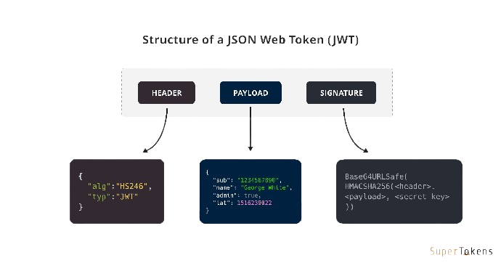
JWT STRUCTER
Decoded

Slide 12

WHY USE JWT
Portable: Easy to send between systems.
Self-Contained: No need for server-side sessions.
Fast: Verifies locally.
Secure: Tamper-proof.

Slide 13
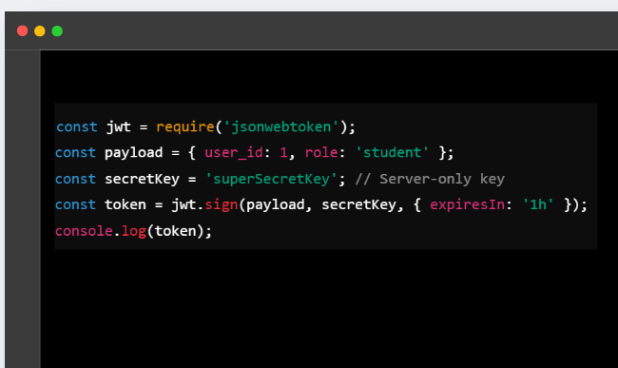
HOW TO CREATE
JWT
Server: Creates and signs the JWT using the secret key.
Client: Receives and stores the token.
Server: Verifies the token by checking the signature with the same secret key.

Slide 14
1)ACESS TOKEN
2)REFRESH TOKEN
Request
send token
SERVER
CLIENT

Slide 15




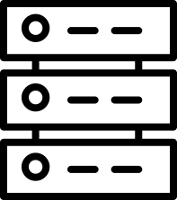
Cookie
TOKEN
Browser
Localhost

Slide 16

CHECK USER AUTHORIZED OR NOT
request for any resource
response the resource
SERVER
CLIENT

Slide 17
THANK YOU!

